Slide 1
License Plate Recognition
Muhammad Kabir Ahmad (2021-CS-4)

Slide 2
Literature View
An Efficient Approach for Number Plate Extraction from vehicles Image under Image Processing
By Sukhvir Kaur in 2014
Steps: Pre-Processing, Number Plate Extraction, Character Segmentation, Character Recognition.
Recognition of Vehicle Number Plate Using Image Processing Technique
By Faizal Patel, Jaimini Solanki, Vivek Rajguru, Ankit Saxena in 2014
Steps: 1)Vehicle Image Captured By camera 2)Extraction of Number Plate Location 3)Display Vehicle Number 4) Segmentaion and Recognition of Plate Character

Slide 3
Literature View
Automatic Vehicle Identification by Plate Recognition
By Serkan Ozbay, and Ergun Ercelebi in 2007
Steps: 1)STRUCTURE OF THE LPR SYSTEM 2) PLATEREGION EXTRACTION 3) SEGMENTATION 4)CHARACTER RECOGNITION 5) EXPERIMEN
Dynamic traffic rule violation monitoring system using automatic number plate recognition with SMS feedback
By R Shreyas, Pradeep Kumar B V, Adithya H B, Padmaja B,Sunil M P in 2017
Steps: 1) Input image from webcam. 2) Convert image into binary. 3) Detect number plate area. 4) Segmentation. 5) Number identification. 6) Save to file in given format

Slide 4
Problem Statement
To detect the Vehicle through their License Plate IDs that were majorly used AS ANPR system for Multiple purpose such as for E-Chllan Ticketing System, for many market building parking system, for toll plazas system and many more.

Slide 5
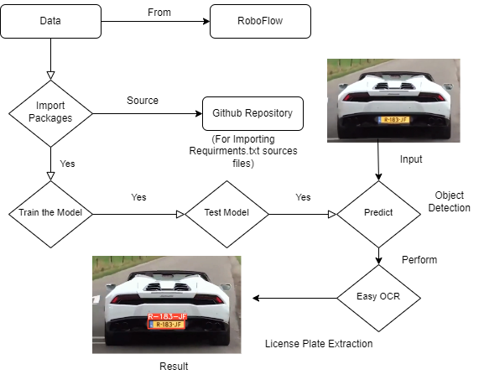
Methodology

Slide 6
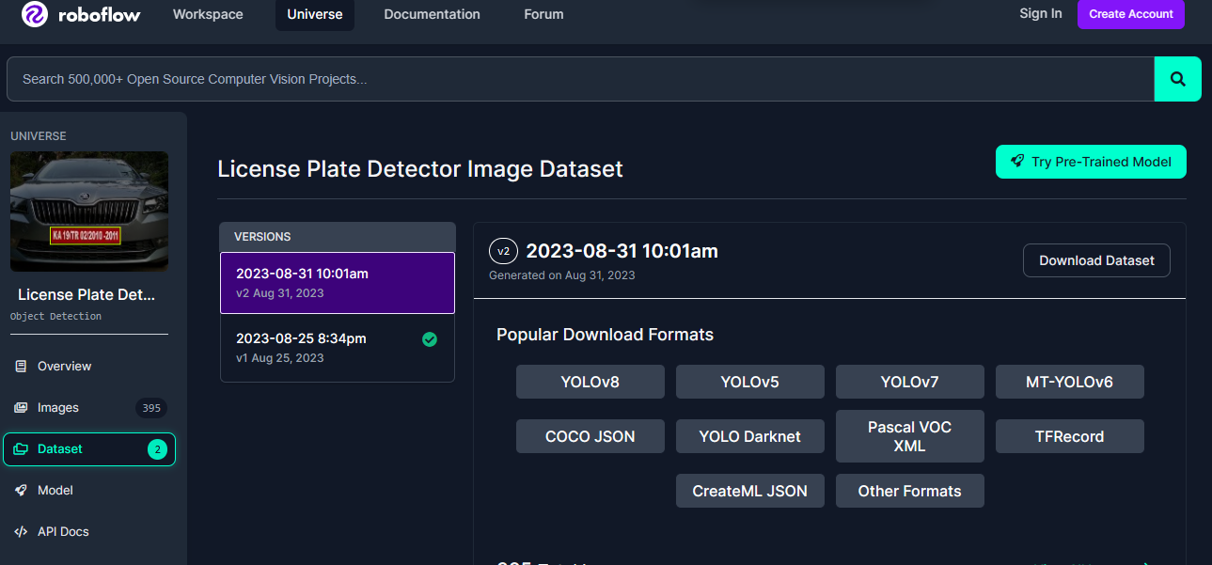
Data Set
Data set contains 400+images
Data set was obtained from Roboflow

Slide 7
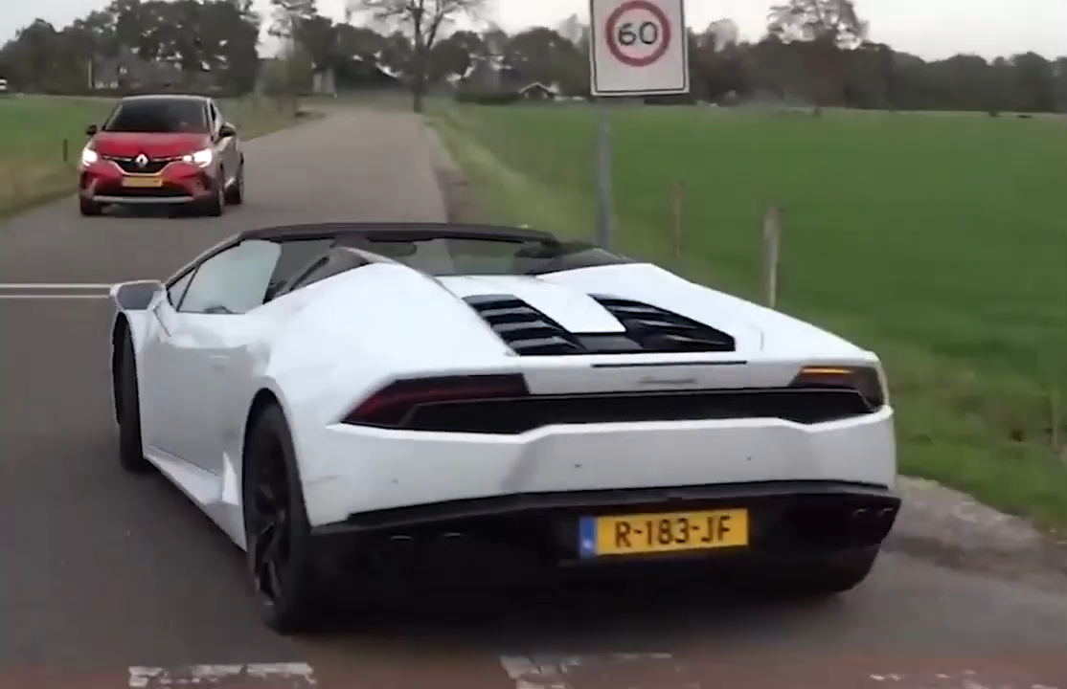
Input Video
The input video demo is
Shown as:

Slide 8
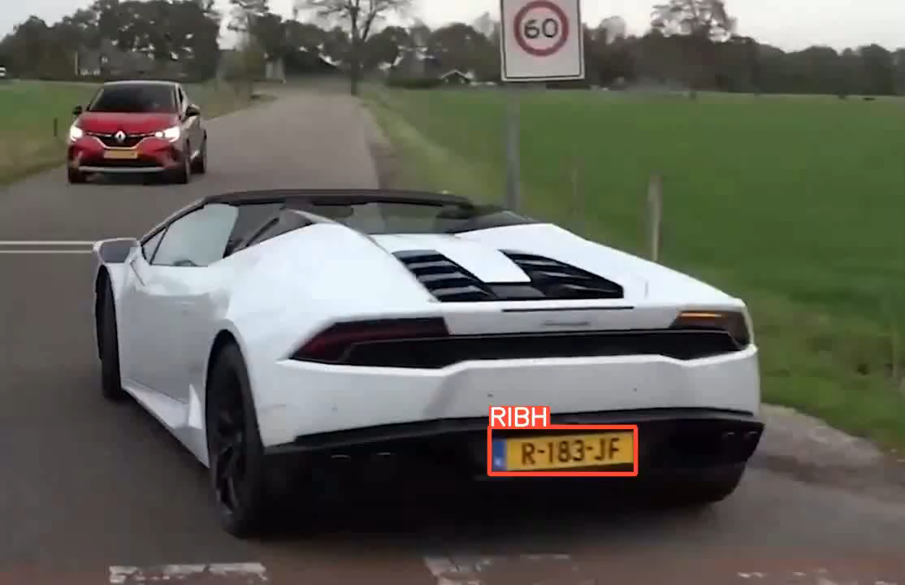
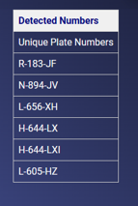
Ouput Result Video
The Output video demo is
Shown as:

Slide 9
Thank You

